Slide 1
Driver character classification
Using ML

Slide 2
Pre Processing
Preprocessing is a crucial data preparation step in machine learning and data analysis.
It involves cleaning, transforming, and organizing raw data into a format suitable for analysis or model training.
Preprocessing tasks can include handling missing values, scaling or normalizing data, encoding categorical variables, and feature selection.
The goal of preprocessing is to enhance data quality, reduce noise, and make it ready for effective analysis, improving the accuracy and efficiency of subsequent data-driven tasks

Slide 3
Pre Processing Steps
Data preprocessing involves several key steps to prepare data for analysis or machine learning.
These steps include handling missing data, dealing with outliers, encoding categorical features, scaling or normalizing data, performing feature engineering, and potentially reducing dimensionality.
It's essential to ensure data quality, consistency, and relevance, and the specific order and techniques used can vary depending on the dataset and the goals of the analysis or modeling task.

Slide 4
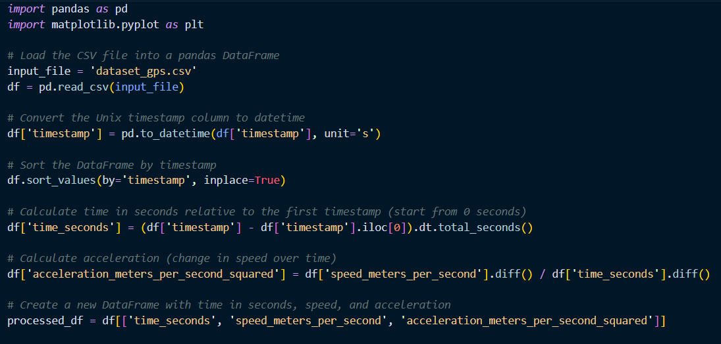
Code

Slide 5
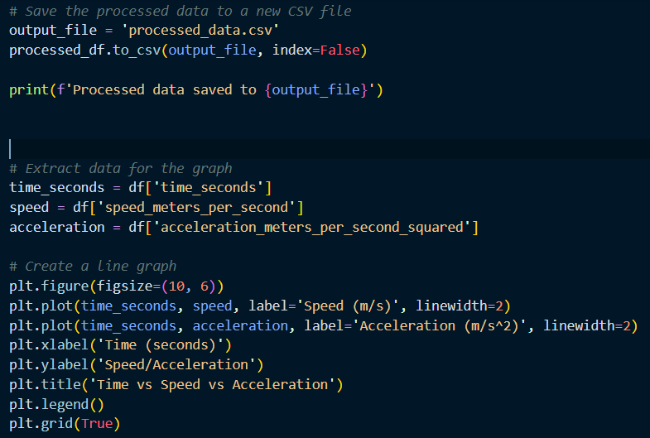
Code

Slide 6
Code
The provided Python script performs data preprocessing on a GPS dataset contained in a CSV file.
It starts by importing the necessary libraries, including pandas for data manipulation and matplotlib for data visualization.
The script then loads the CSV data, converting a Unix timestamp column to a datetime format and sorting the DataFrame by timestamp.
Next, it calculates the time in seconds relative to the first timestamp and computes the acceleration in meters per second squared.
The processed data is stored in a new DataFrame and saved to a separate CSV file.

Slide 7
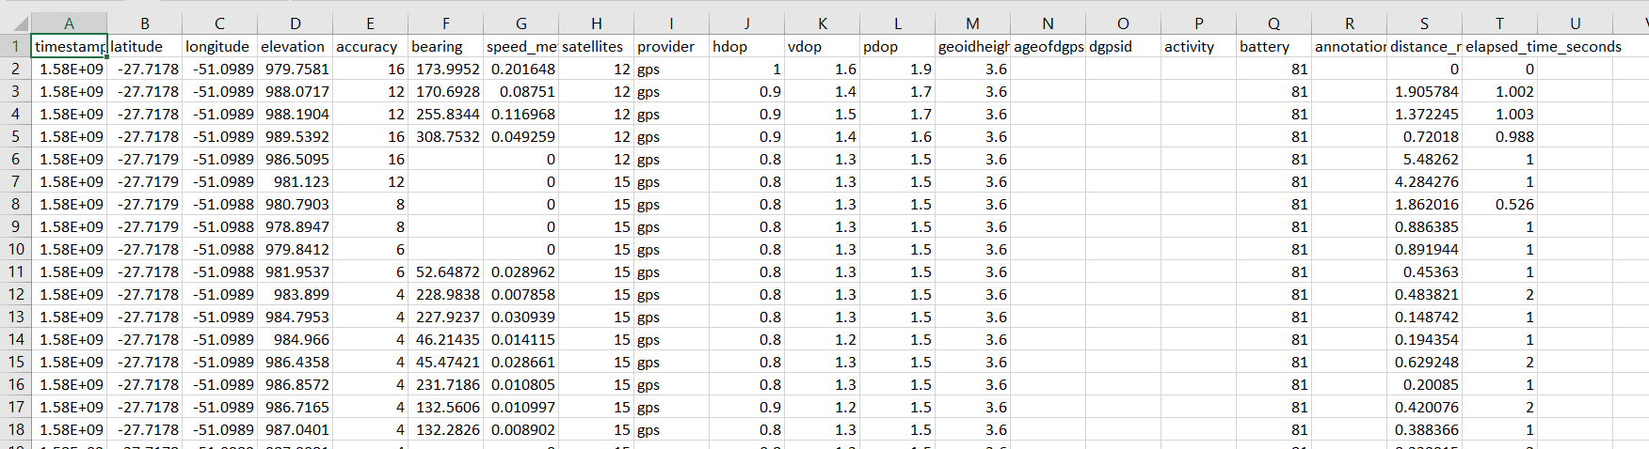
Input

Slide 8
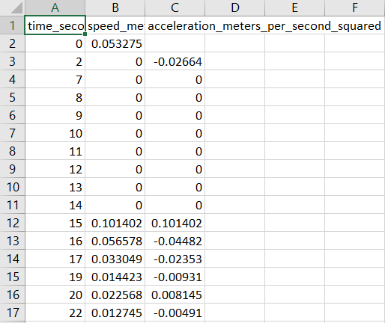
output

Slide 9
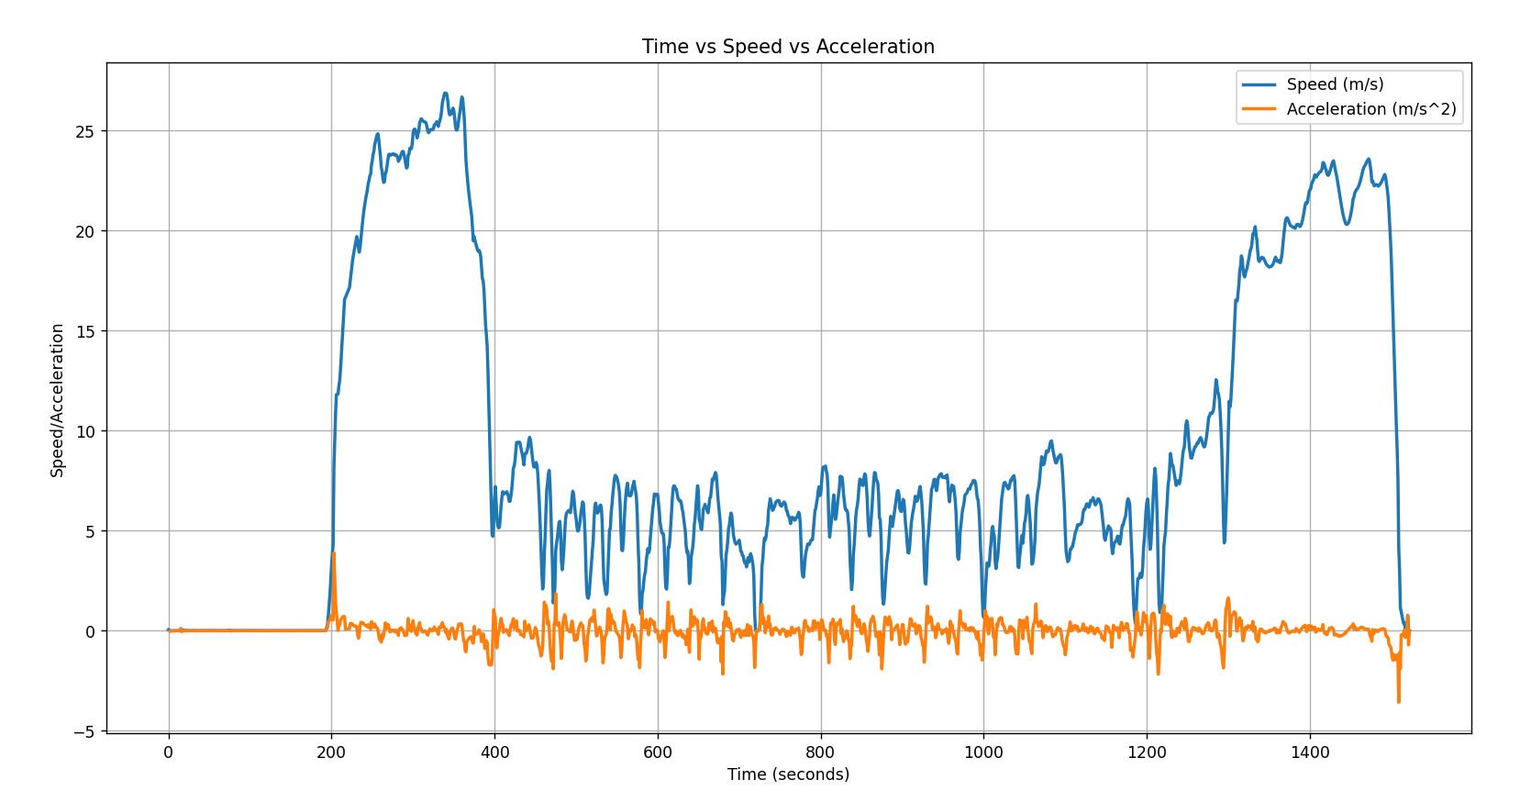
Visualization

Slide 10
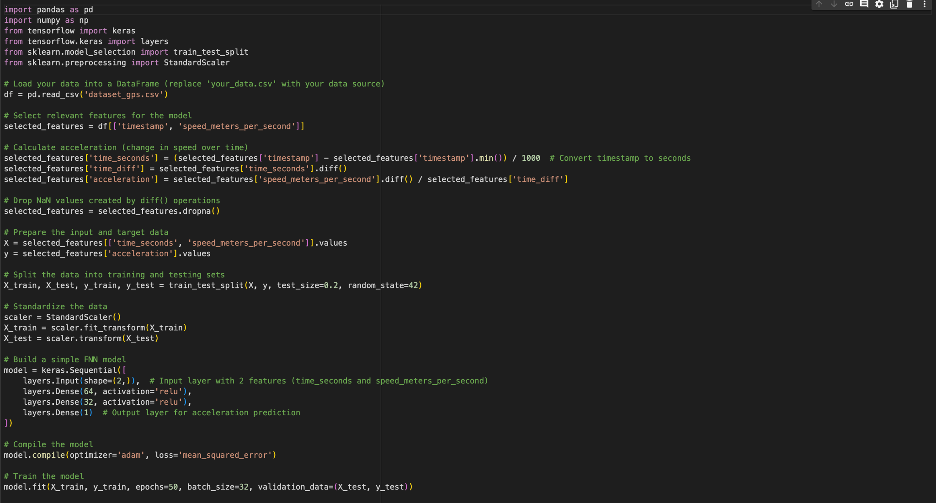

Slide 11
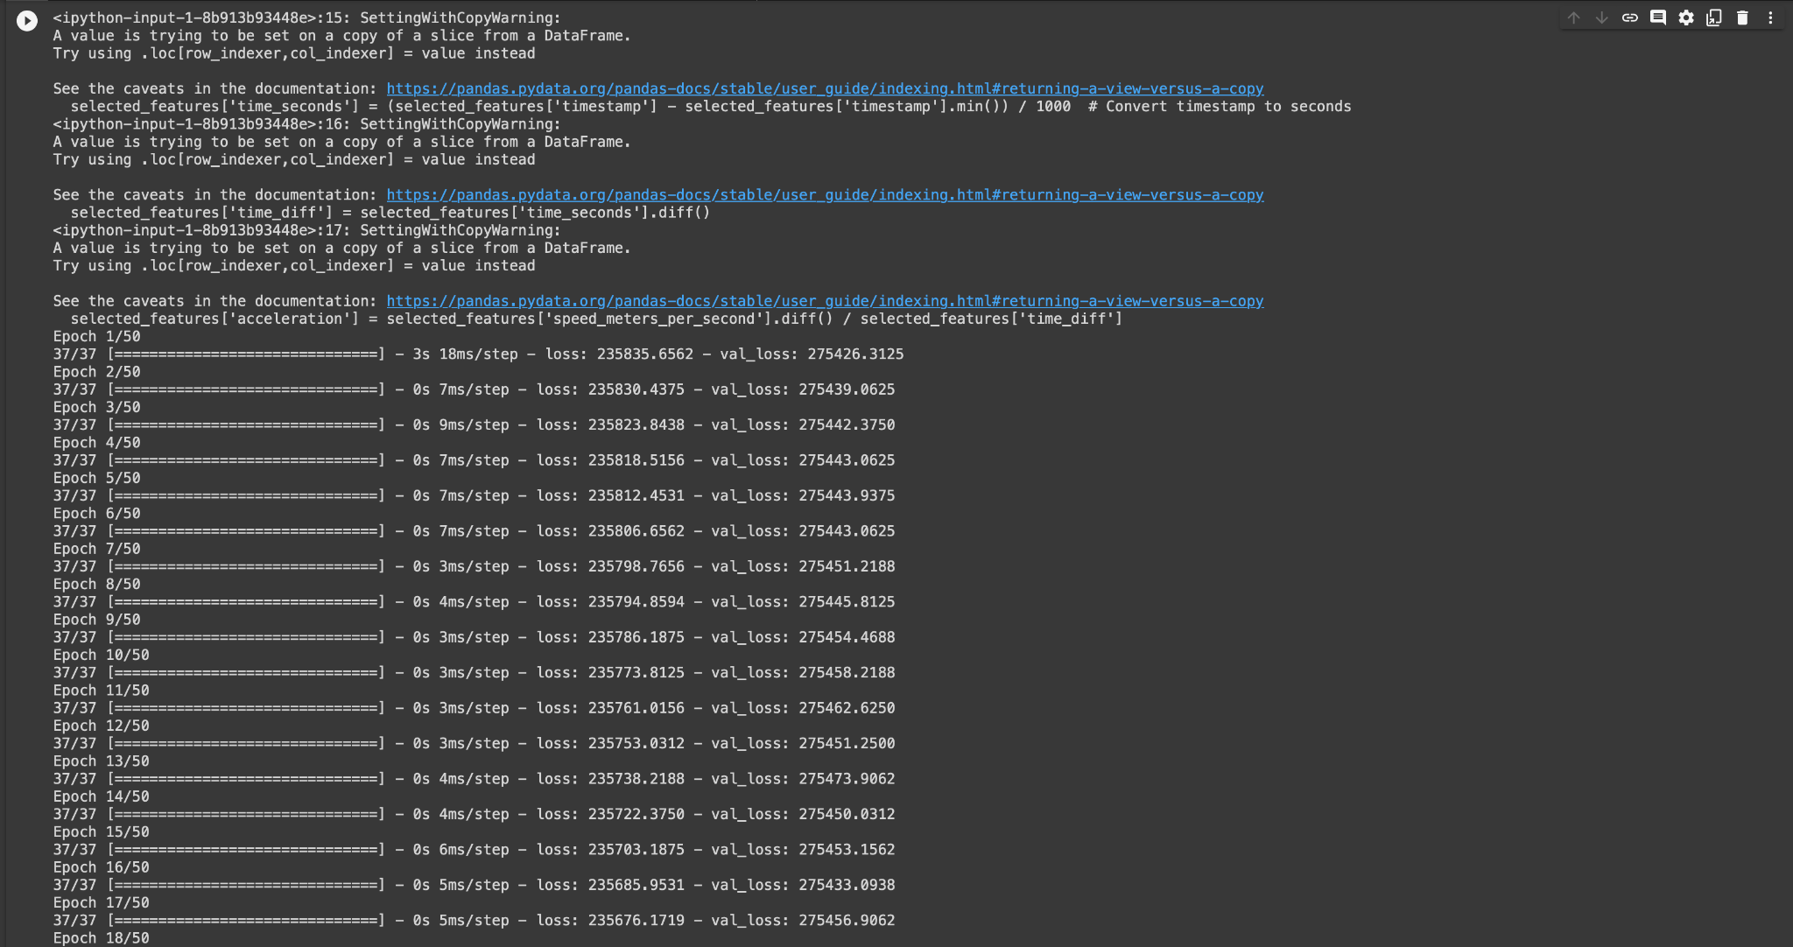

Slide 12
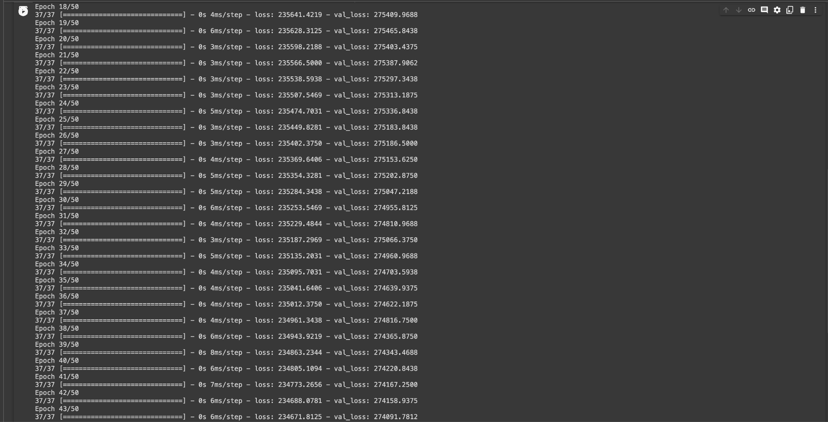

Slide 13
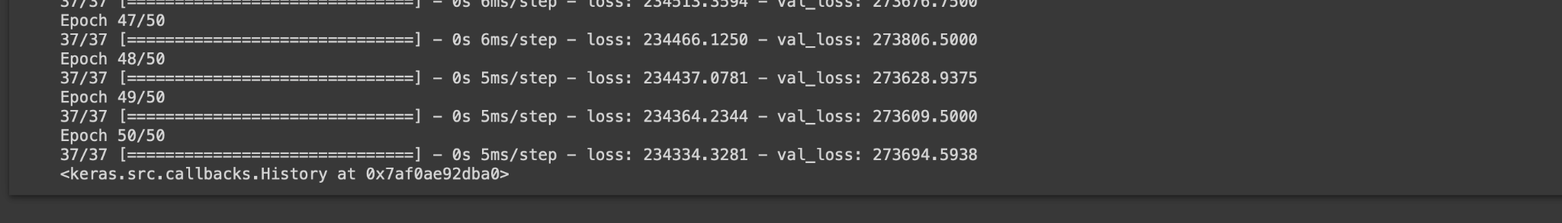

Slide 14
CLASSIFICATION MODEL
Feedforward Neural Networks (FNN)
Also known as a Multi-Layer Perceptron (MLP), is one of the simplest and most common types of artificial neural networks.
It is used for a variety of machine learning tasks, including classification and regression.
Data flows through the network in one direction, from input to output, without any feedback loops or recurrent connections.

Slide 15
FNN Layers
Input Layer: This layer receives the raw input data. Each neuron in the input layer corresponds to a feature or input variable.
Hidden Layers: These are one or more layers between the input and output layers. Each neuron in a hidden layer is connected to every neuron in the previous and subsequent layers. These layers perform complex transformations on the input data.
Output Layer: The final layer produces the network's output, which could be a classification label, a regression value, or some other desired prediction.

Slide 16
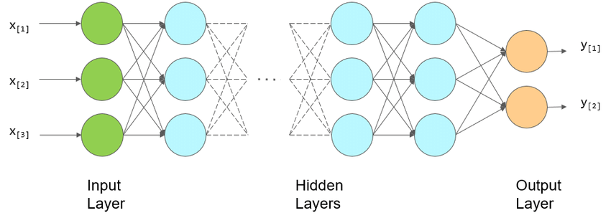

Slide 17
Each neuron in the network receives input values, applies a weighted sum, adds a bias term, and then passes the result through an activation function. The activation function introduces non-linearity into the model, allowing it to learn complex relationships in the data.
Training: FNNs are trained using supervised learning. During training, the network's weights and biases are adjusted to minimize the difference between the predicted output and the actual target values. This is typically done using optimization algorithms like gradient descent and backpropagation.
Activation Functions: Common activation functions used in FNNs include sigmoid, hyperbolic tangent (tanh), and rectified linear unit (ReLU). The choice of activation function can impact the network's capacity to learn and the training process.

Slide 18
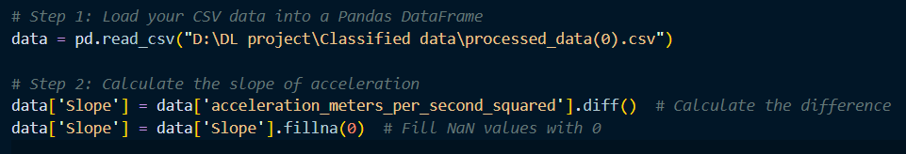
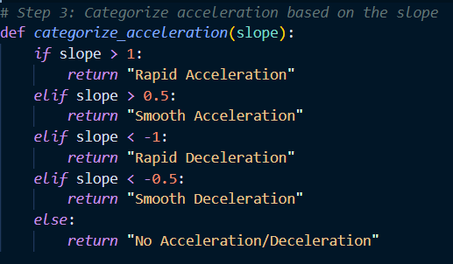

Slide 19
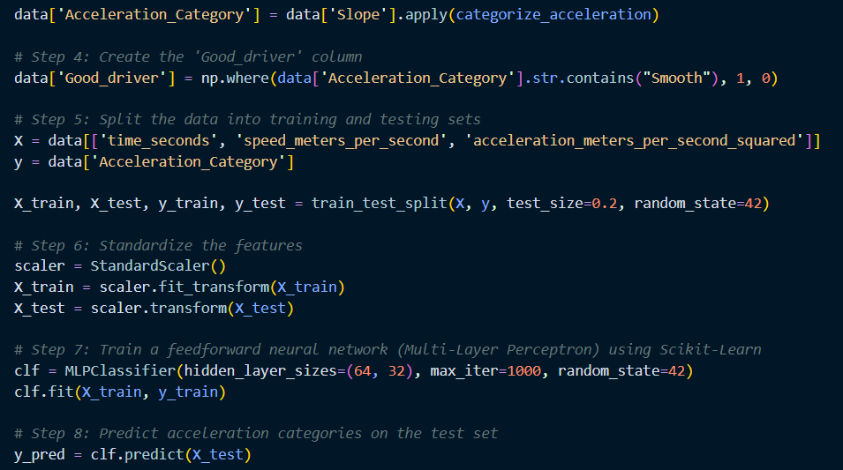

Slide 20
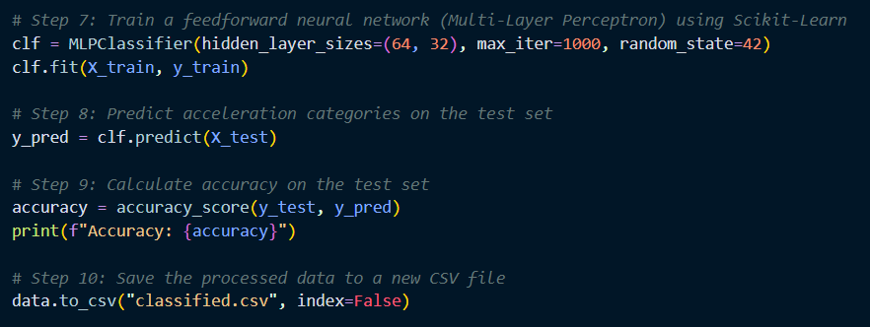

Slide 21
MATLAB Implementation
In MATLAB, classifier models are essential tools for solving classification problems. These models include Support Vector Machines (SVM), K-Nearest Neighbors (K-NN), Naive Bayes, Decision Trees, Random Forest, and more.
MATLAB provides a versatile environment for creating, training, and evaluating these classifiers.
Whether you need to classify data into categories or make predictions, MATLAB's machine learning and statistics toolboxes offer a range of options for building accurate and efficient classification models tailored to your specific needs.

Slide 22
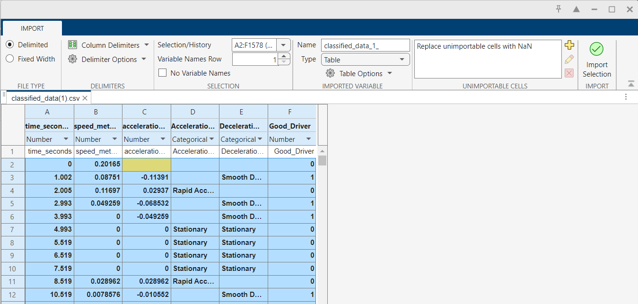
Importing table values

Slide 23
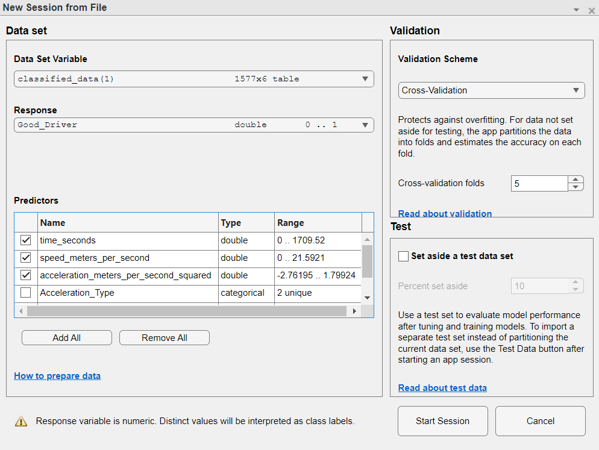
Creating session

Slide 24
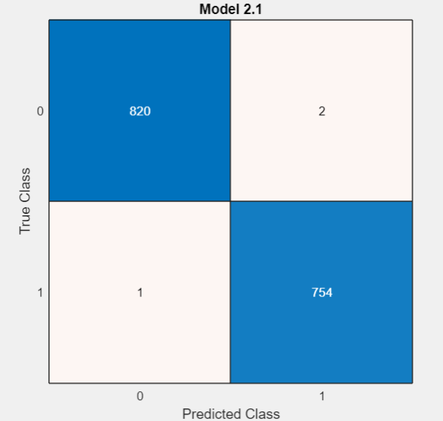
Confusion matrix

Slide 25
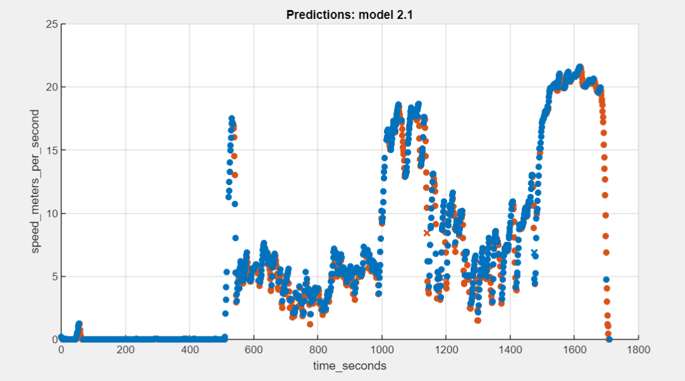
Scatter plot

Slide 26
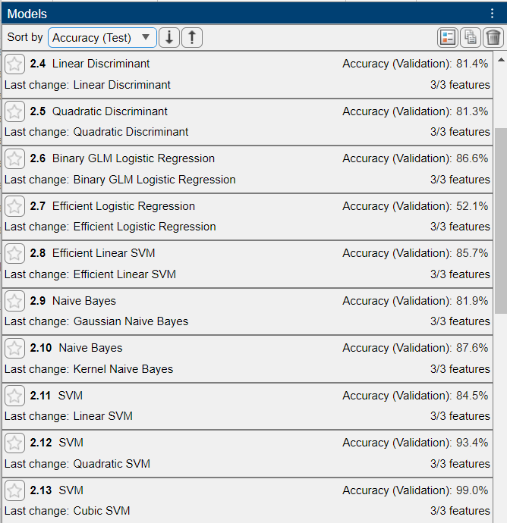
Training

Slide 27
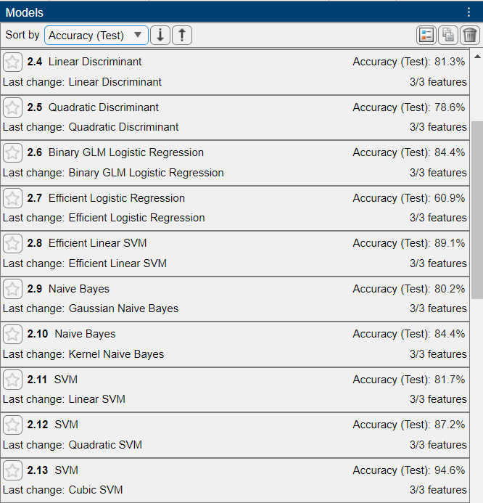
Testing

Slide 28
Python Model Implementation
This implementation focuses on the development of a robust and user-friendly driver behavior classifier system using Python.
The primary objective is to create a model capable of discerning between "good" and "bad" driver behavior based on key driving metrics.
Leveraging the power of the Logistic Regression algorithm, this project showcases the entire process, from data preprocessing to model training.
Furthermore, a graphical user interface (GUI) has been incorporated to empower users with a straightforward tool for real-time assessment of driving behavior, along with compelling visualizations.
This comprehensive approach ensures the practicality and effectiveness of the system, aligning it with applications in the realms of road safety and autonomous driving systems.

Slide 29
Model used :
The core of this driver behavior classifier system relies on the implementation of a Logistic Regression model. Logistic Regression is a well-established and interpretable classification algorithm that is exceptionally well-suited for binary classification tasks, such as distinguishing between "good" and "bad" driver behavior.
Logistic Regression Algorithm: Logistic Regression operates by transforming a linear combination of input features into a probability score, which is then mapped to a binary outcome.

Slide 30
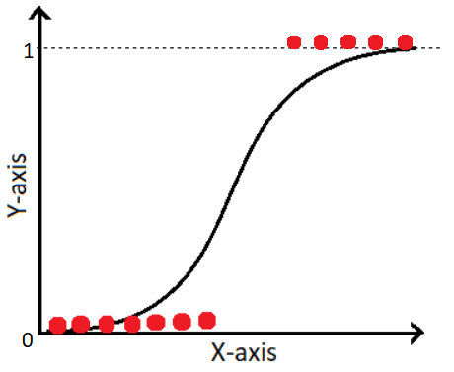
This type of statistical model (also known as logit model) is often used for classification and predictive analytics.
Logistic regression estimates the probability of an event occurring, such as voted or didn’t vote, based on a given dataset of independent variables.
Since the outcome is a probability, the dependent variable is bounded between 0 and 1.
In logistic regression, a logit transformation is applied on the odds—that is, the probability of success divided by the probability of failure.
This is also commonly known as the log odds, or the natural logarithm of odds, and this logistic function is represented by the following formulas:
Logit(pi) = 1/(1+ exp(-pi))
ln(pi/(1-pi)) = Beta_0 + Beta_1*X_1 + … + B_k*K_k

Slide 31
In this logistic regression equation, logit(pi) is the dependent or response variable and x is the independent variable.
The beta parameter, or coefficient, in this model is commonly estimated via maximum likelihood estimation (MLE).
This method tests different values of beta through multiple iterations to optimize for the best fit of log odds.
All of these iterations produce the log likelihood function, and logistic regression seeks to maximize this function to find the best parameter estimate.
Once the optimal coefficient (or coefficients if there is more than one independent variable) is found, the conditional probabilities for each observation can be calculated, logged, and summed together to yield a predicted probability.
For binary classification, a probability less than .5 will predict 0 while a probability greater than 0.5 will predict 1.

Slide 32
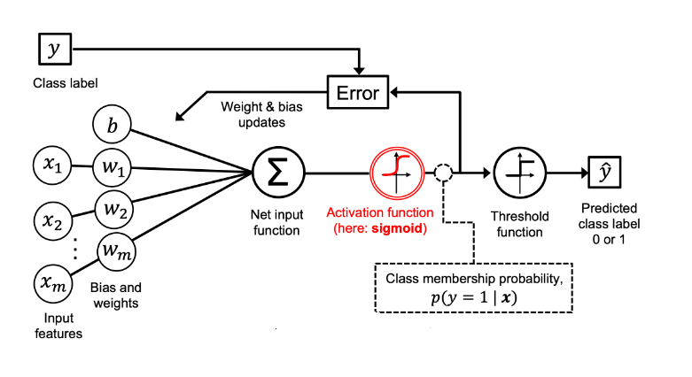

Slide 33
Initialization:
Initialize model parameters (weights and bias).
Set hyperparameters (learning rate, epochs).
Sigmoid Function:
Define the sigmoid function.
Training:
For each training sample:
Calculate predicted probability using the sigmoid function.
Compute the error or loss.
Update model parameters using gradient descent.
Model Evaluation:
Assess the model's performance on a validation or test dataset.
Calculate evaluation metrics.
Prediction:
Use the trained model to make predictions on new data.
Thresholding:
Apply a threshold (usually 0.5) to obtain binary classification results.
Interpretation:
Examine feature weights for model interpretation.
Conclusion:
Apply the model to real-world classification tasks.

Slide 34
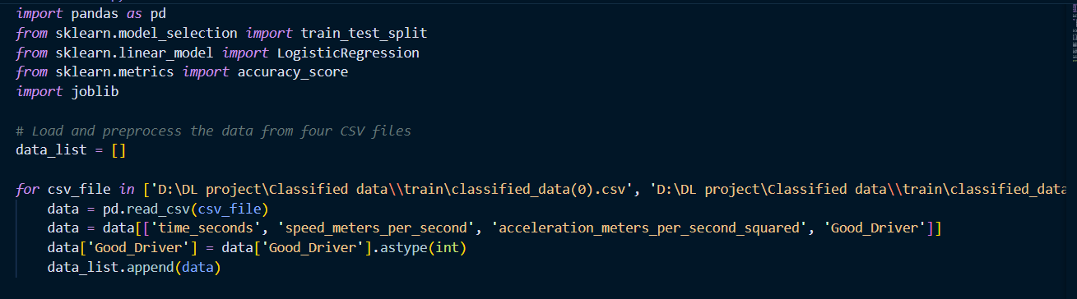
Code :
Training Code Explanation:
The training code for the driver behavior classifier model using Logistic Regression consists of several key steps:
Data Preprocessing:
The initial phase involves loading and preprocessing the training data. Relevant columns, such as time, speed, acceleration, and the target variable (good or bad driving), are selected. Missing data is handled, outliers are addressed, and features are scaled and encoded as needed.

Slide 35
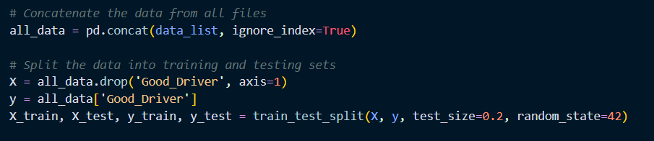
Data Splitting:
The dataset is divided into training and testing subsets to evaluate the model's performance. An 80/20 split is commonly used, with 80% of the data allocated for training and 20% for testing.

Slide 36
Model Selection:
In this case, Logistic Regression is chosen as the classification algorithm. This algorithm is appropriate for binary classification, making it suitable for distinguishing between "good" and "bad" driver behavior.
Model Training:
The selected model is trained using the training dataset. During training, the model learns to adjust its parameters (weights and bias) to minimize the difference between its predictions and the true target labels. This is achieved through gradient descent and backpropagation.
Model Evaluation:
The trained model is evaluated using the testing dataset. Various evaluation metrics, such as accuracy, precision, recall, and the confusion matrix, are computed to assess the model's effectiveness in classifying driver behavior.

Slide 37
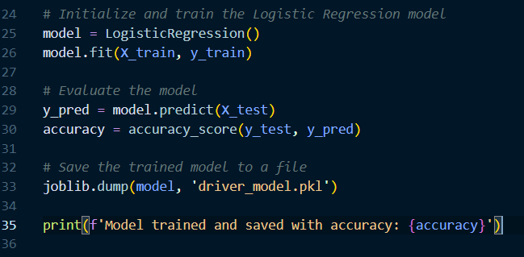

Slide 38
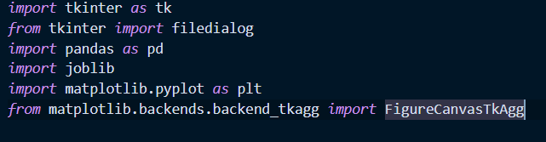
Output
GUI - Interface

Slide 39
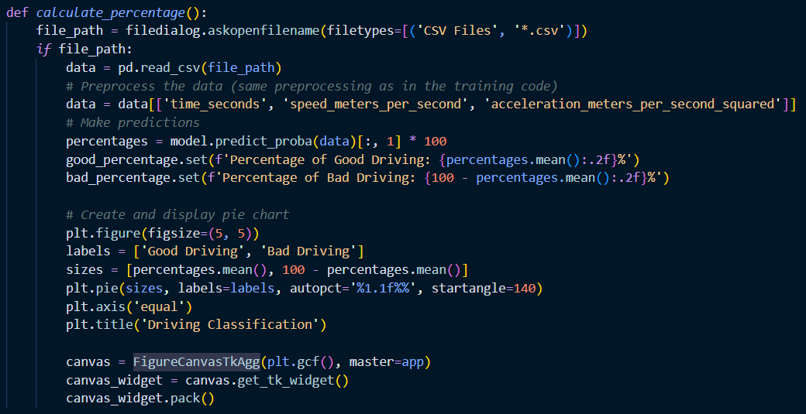
File Import:
Users can interact with the GUI to select and import their own CSV files containing driving data. This step allows customization and real-world application of the model.
Percentage Display:
The GUI displays the percentage of "good" and "bad" driving behavior based on the input data and the trained Logistic Regression model. This information is presented to users in a clear and understandable manner.

Slide 40
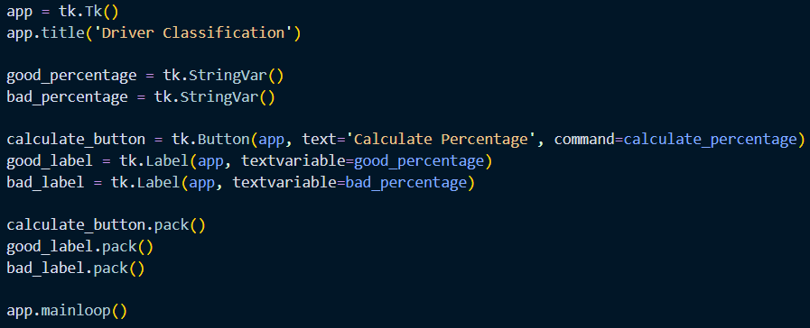

Slide 41
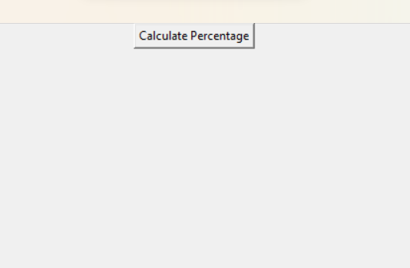
Output

Slide 42
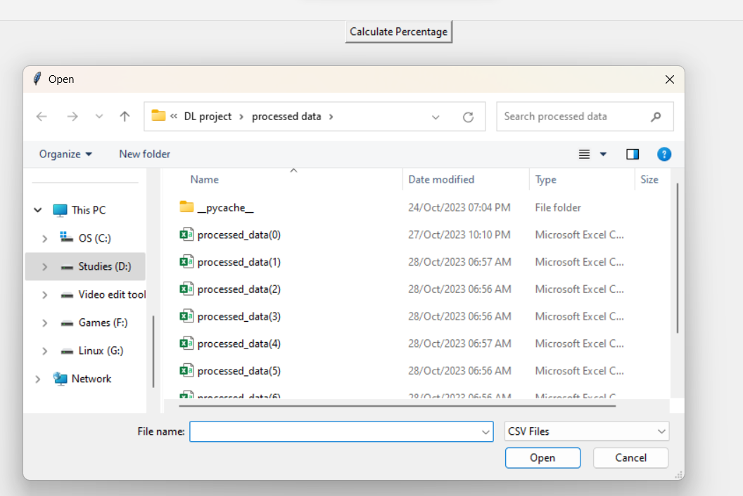

Slide 43
